Slide 1

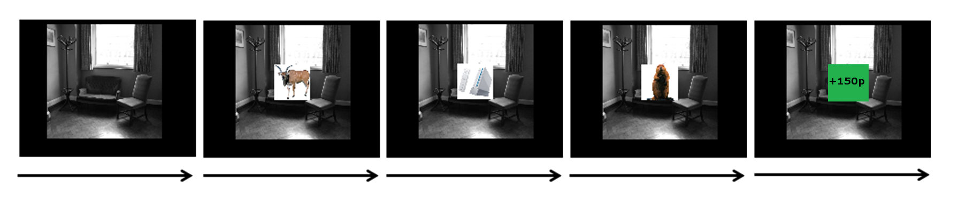
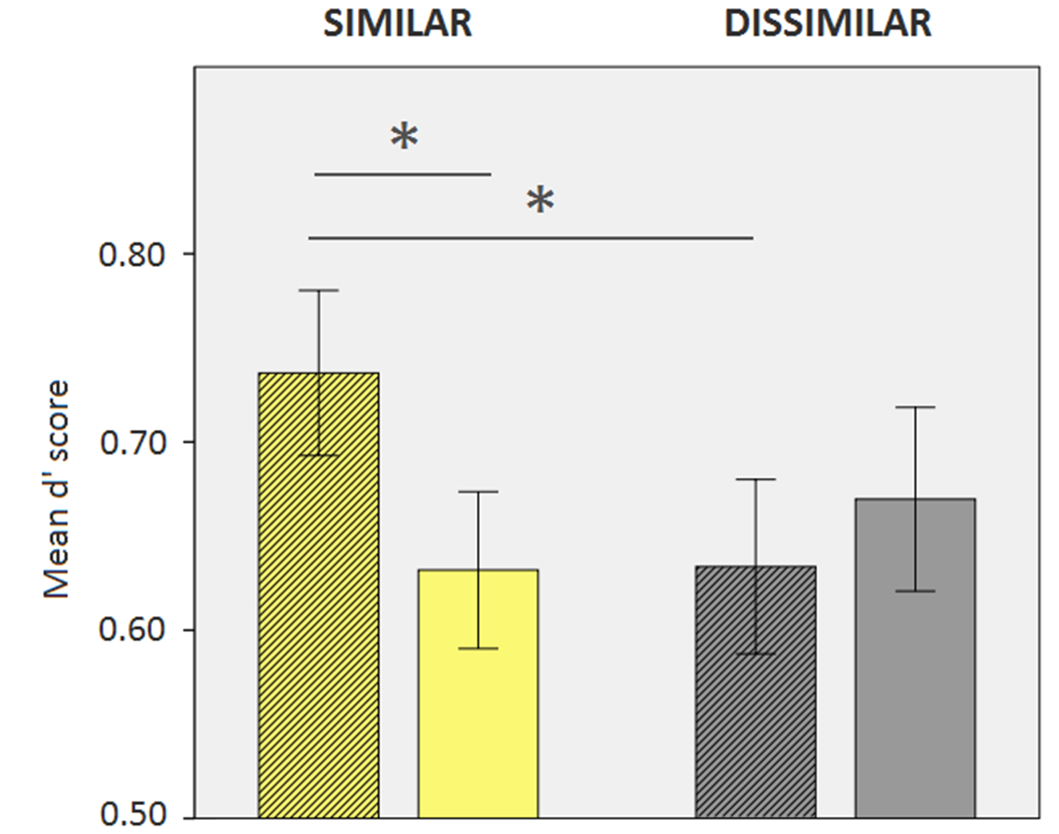
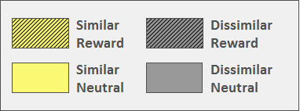
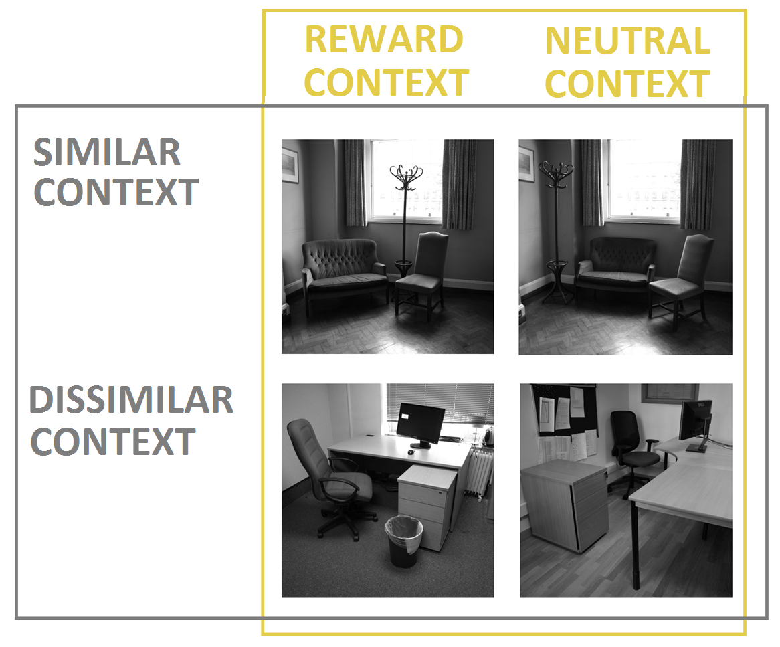
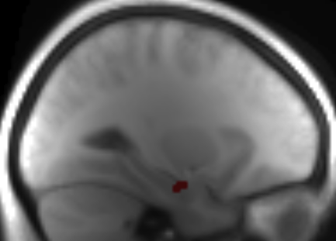
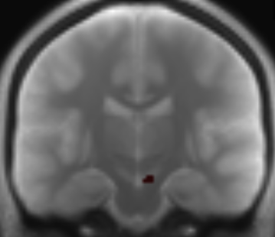
The Hippocampal-VTA Loop and the Contextual Modulation of Memory by Reward
Eleanor Loh, Dharshan Kumaran, Ray Dolan, Emrah Duzel
Wellcome Trust Centre for Neuroimaging, University College London
Dopaminergic enhancements to episodic memory may differ in their stimuls-specificity: Although reward and novelty are thought to enhance memory via shared (dopaminergic) mechanisms^{1,2}, reward-related memory enhancements are stimulus-specific (improving memory for the reward-predicting stimulus only)³ while novelty produces a generalized memory enhancement for other stimuli that occur in close temporal proximity⁴.
Possible explanation: Novelty produces generalized memory enhancement because it drives the Hippocampal-VTA loop, which is hypothesized to gate entry to episodic memory⁵. Since reward associations do not necessarily drive this circuit, its enhancements preserve their stimulus-specificity.
Research question: Do reward-related memory enhancements generalize for rewarding events that do drive the Hippocampal-VTA loop (e.g. where cue invokes hippocampal pattern separation)?
Method
Results
Items were more likely to be remembered if they were presented with a Rewarded context – but only in the Similar condition (Similarity x Valence interaction, F(1,24)=4.64, p=0.04)
4000 ms 2000 ms 2000 ms 2000 ms 2000 ms
Encoding: Reward availability is predicted by context stimuli (background picture), rather than by the items to be remembered. If reward is available, subjects earn money by making quick and accurate semantic judgments to each item (+50p each).
Memory test: (5 days later) Memory for the Items is tested
Recruiting the hippocampus by invoking Pattern Separation
Activity in the Left Hippocampus and SN/VTA increased as a function of later recall – but again, only in the Similar condition
Pair discrimination requires pattern separation by the hippocampus
Pair discrimination does not require the hippocampus
fMRI model The BOLD response to the different Context presentations was modelled, with parametric modulators specifying the memory score for each Context presentation (i.e. how many items presented with this Context were later successfully recalled). These parametric modulators were included in a 2x2 ANOVA (Similarity x Valence) at the 2nd level.
Result Hippocampus and SN/VTA clusters were found in the Similarity x Valence interaction. Clusters shown (significant at p=0.005 uncorrected) are derived from the contrast Similar-Rewarded – Similar-Neutral. No such clusters were found comparing the Dissimilar contexts.
Left Hippocampus cluster: 28 voxels; Peak voxel at -28, -12, -20; t(92)=3.48, p<0.001 uncorrected.
Right SN/VTA cluster: 26 voxels; Peak voxel at 6, -18, -18; t(92)=3.25, p=0.001 uncorrected.
Hippocampal-VTA loop engagement is manipulated by varying the hippocampal pattern-separation demands of context-pair discrimination (by varying within-pair similarity).
Conclusion
Although reward-related enhancements of memory are typically stimulus-specific, recruitment of the hippocampal-VTA loop allows such enhancement to generalize to temporally co-occurring stimuli.
Engagement of the Hippocampal-VTA loop may determine the generalizability of dopaminergic enhancements to memory
Characteristics of VTA dopamine firing may potentially differ according to which inputs are driving the VTA. Hippocampally-driven responses in particular may have particular qualities that lend themselves to generalized memory enhancements
1. Lisman, J. et al. (2011). A neoHebbian framework for episodic memory; role of dopamine-dependent late LTP. Trends in Neurosciences, 34(10), 536-547.
2. Frey, U. et al. (1990) Dopaminergic antagonists prevent long-term maintenance of post-tetanic LTPin the CA1 region of rat hippocampal slices. Brain Res. 522, 69–75
3. Wittmann, B. et al. (2011) Behavioural speciﬁcations of rewardassociated long-term memory enhancement in humans. Learn. Mem. 18, 296–300
4. Fenker,D.B. et al.(2008) Novel scenes improve recollection and recallof words. J. Cogn. Neurosci. 20, 1250–1265
5. Lisman, J.E. et al. (2005) The hippocampal-VTA loop: controlling the entry of information into long term memory. Neuron, 46(5), 703-13.

